Slide 1
Chongqing University of Technology
ATAI
Advanced Technique of Artificial Intelligence
Chongqing University of Technology
Be More with Less_ Hypergraph Attention Networks for Inductive Text Classification（EMNLP 2020 ）
彭展望
Code:https://github.com/kaize0409/HyperGAT

Slide 2
Outline
Introduction
Related Work
Method
Experiment
Conclusion

Slide 3
Introduction
Two shortcomings：
Expressive Power:
Instance : eat humble pie
pairwise connections
humble – pie and eat – pie
Computational Consumption:
Graph Convolutional Networks for Text Classification (AAAI-2019)

Slide 4
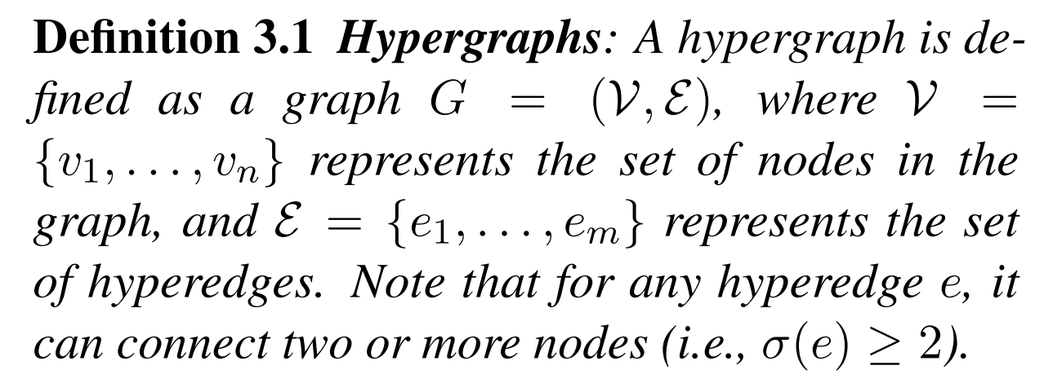
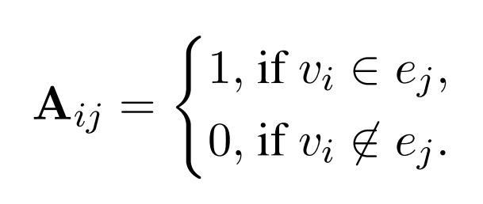
Method
Sequential Hyperedges:
Inspired by the success of hierarchical attention networks (Yang et al., 2016), here we consider each sentence as a hyperedge and it connects all the words in this sentence.
Semantic Hyperedges:
mine the latent topics T from the text documents using LDA (Blei et al., 2003) and each topic $t_{i}=(θ_{1},…,θ_{w})$($w$ denotes the vocabulary size) can be represented by a probability distribution over the words. Then for each topic, we consider it as a semantic hyperedge that connects the top K words with the largest probabilities in the document.

Slide 5
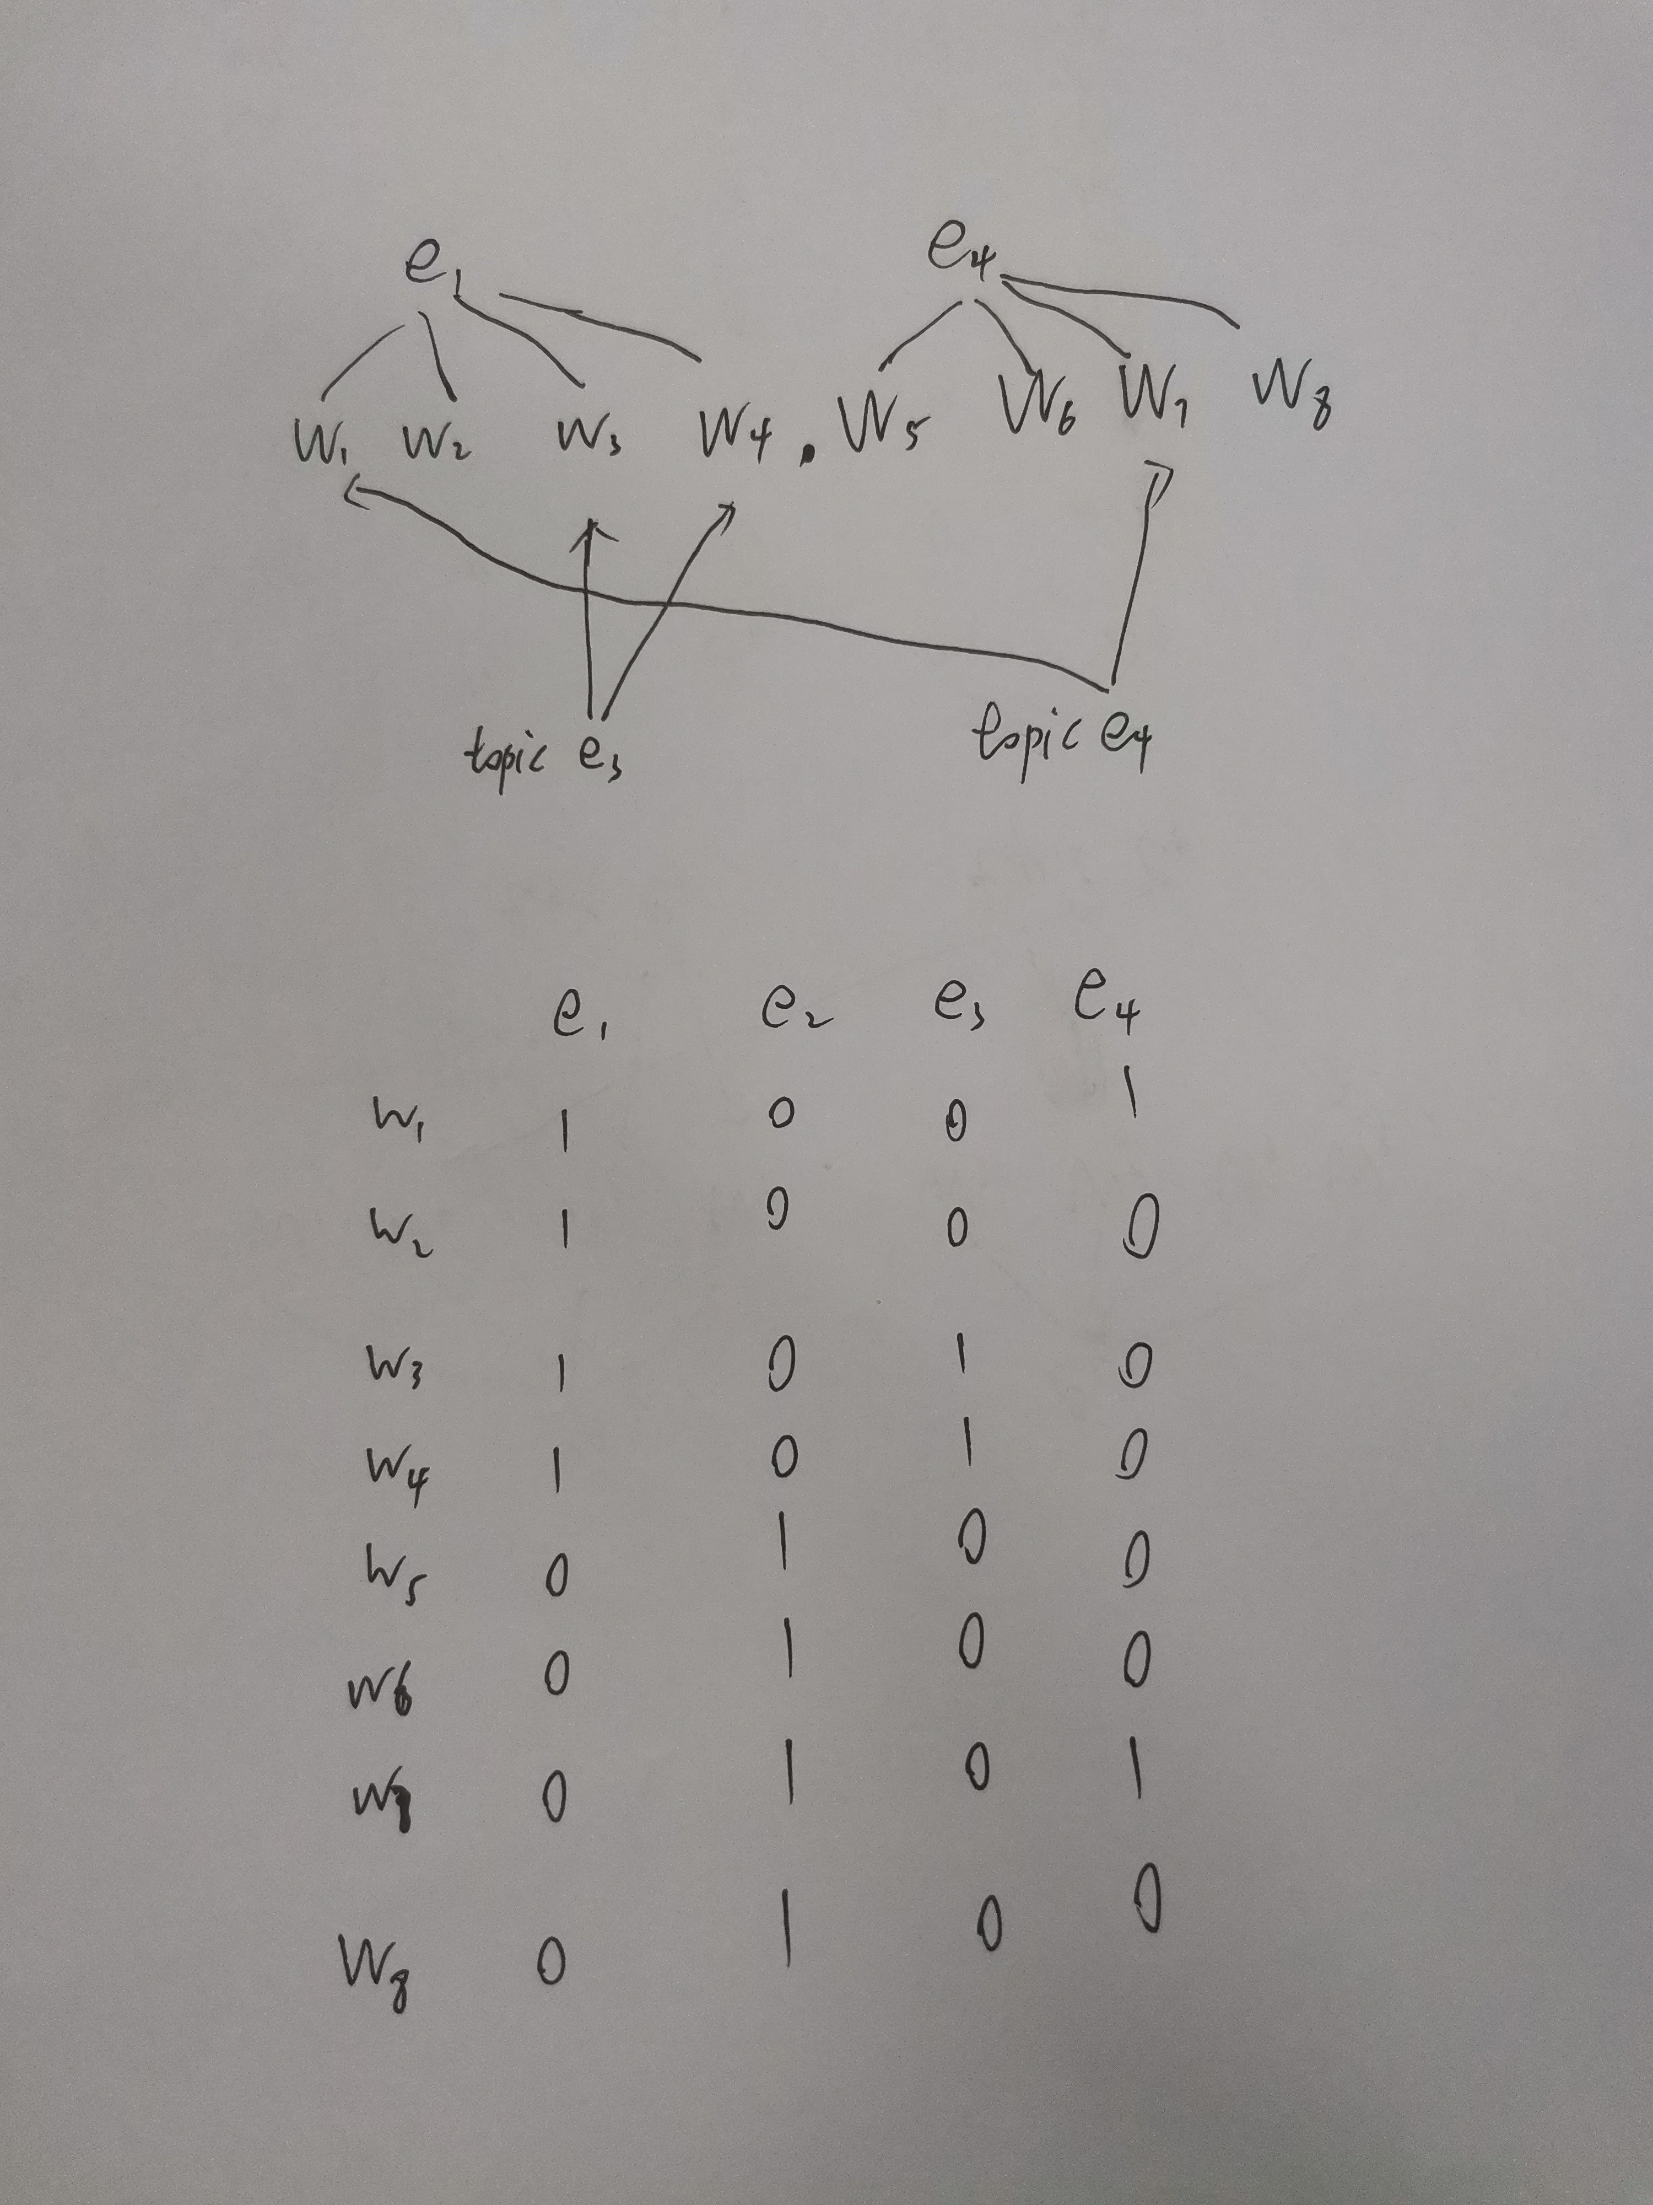
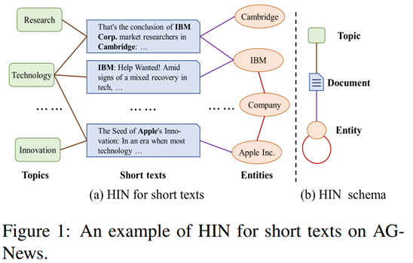
Star Graph Neural Networks for Session-based Recommendation （CIKM2020）
每个数据集分几类，就有几个topic
Be More with Less_ Hypergraph Attention Networks for Inductive Text Classification（EMNLP 2020 ）
Heterogeneous Graph Attention Networks for Semi-supervised Short Text Classification (EMNLP 2019) (朱玲)

Slide 6
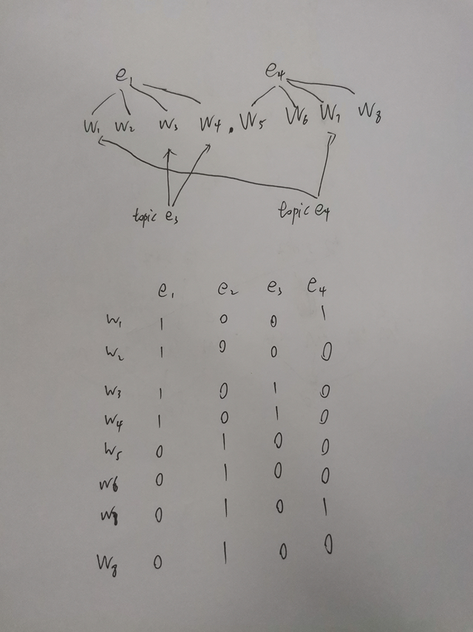
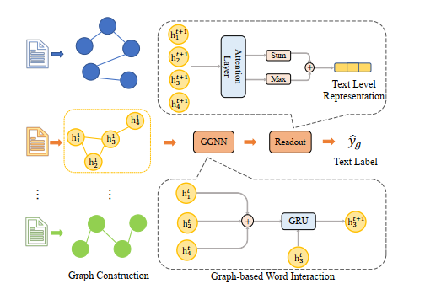
每个数据集分几类，就有几个topic
Be More with Less_ Hypergraph Attention Networks for Inductive Text Classification（EMNLP 2020 ）

Slide 7
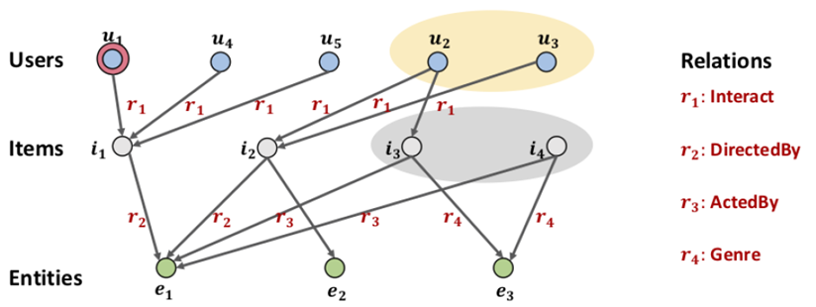
[1] kdd_2019_KGAT Knowledge Graph Attention Network for Recommendation (kdd, 2019)

Slide 8
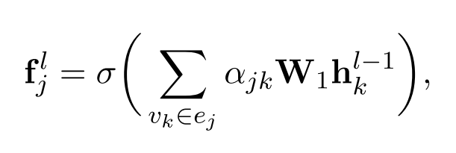
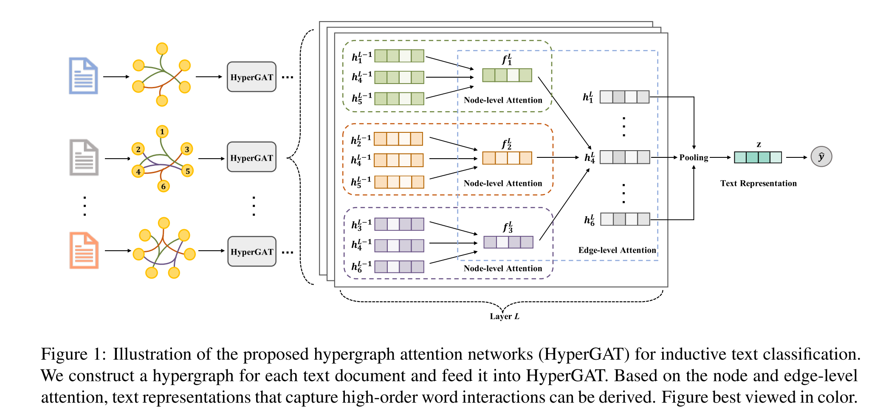
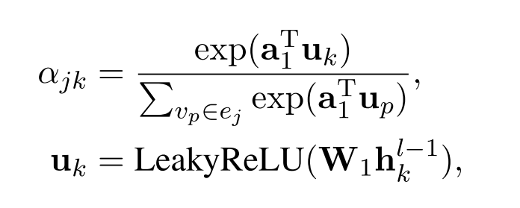
Hypergraph Attention Networks
Node-level Attention
where $σ$ is the nonlinearity such as ReLU and $W_{1}$is a trainable weight matrix

Slide 9
Hypergraph Attention Networks
Edge-level Attention
where $h_{i}^{l}$ is the output representation of node $v_{i}$ and $W_{2}$ is a weight matrix
where $a_{2}^{T}$ is another weight (context) vector for measuring the importance of the hyperedges and || is the concatenation operation.

Slide 10
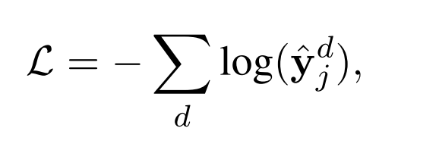
Inductive Text Classification:
$$z=mean−pooling(H^{L})$$
Notes:
$$z=mean−pooling(H^{L})$$

Slide 11
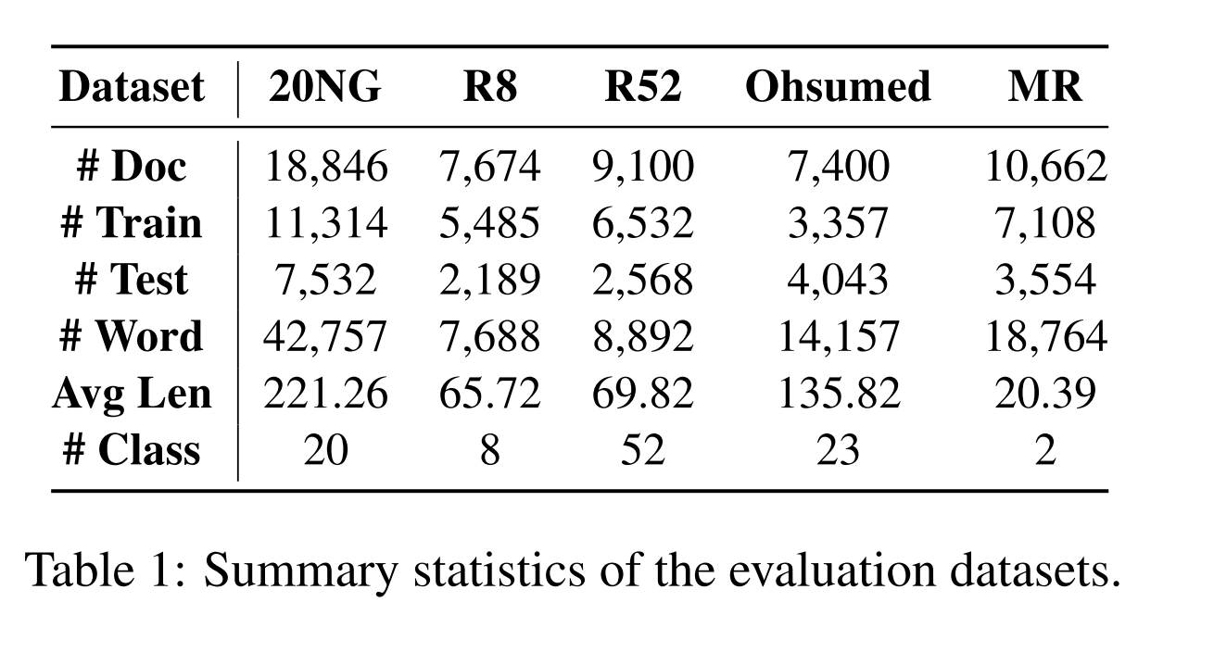
Dataset

Slide 12
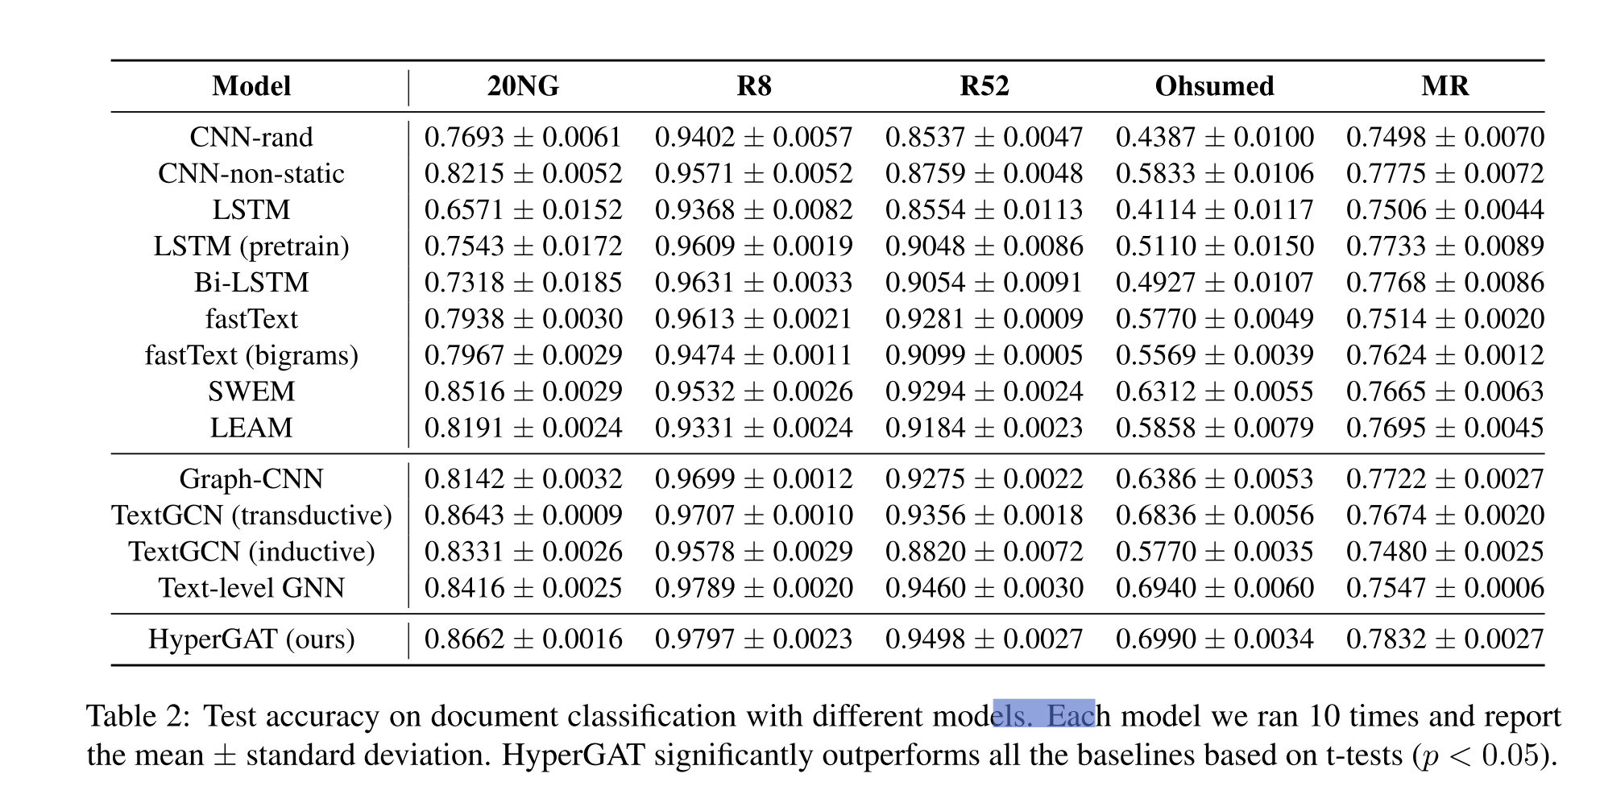
Experiment

Slide 13
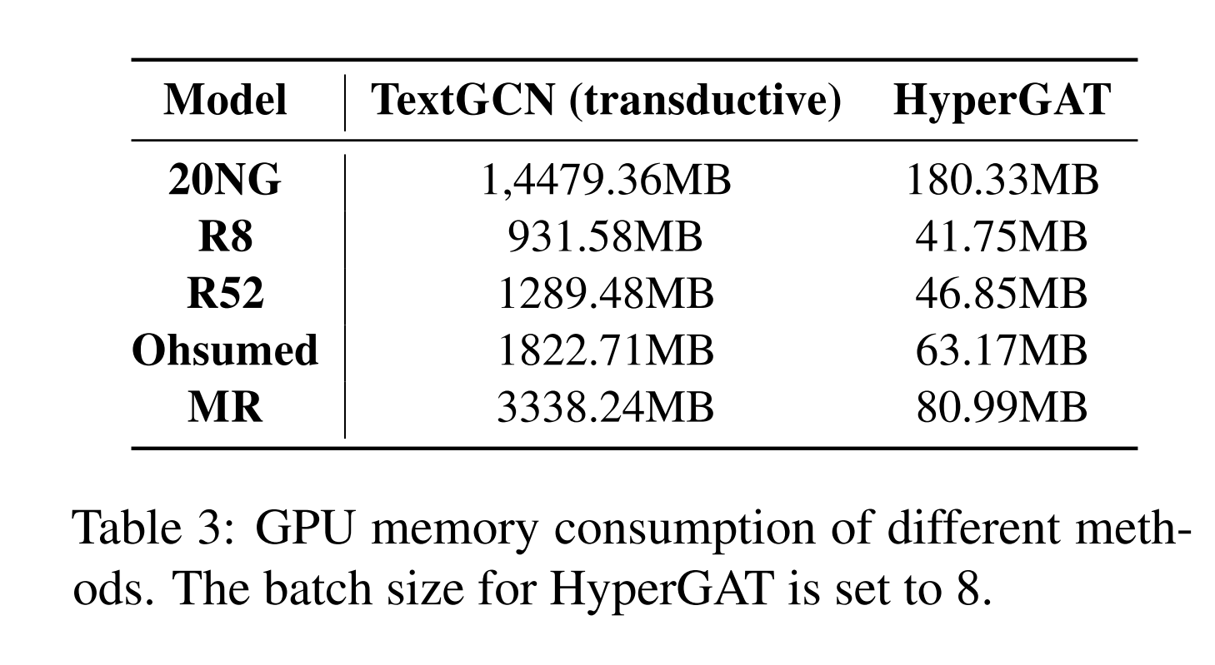
Experiment

Slide 14
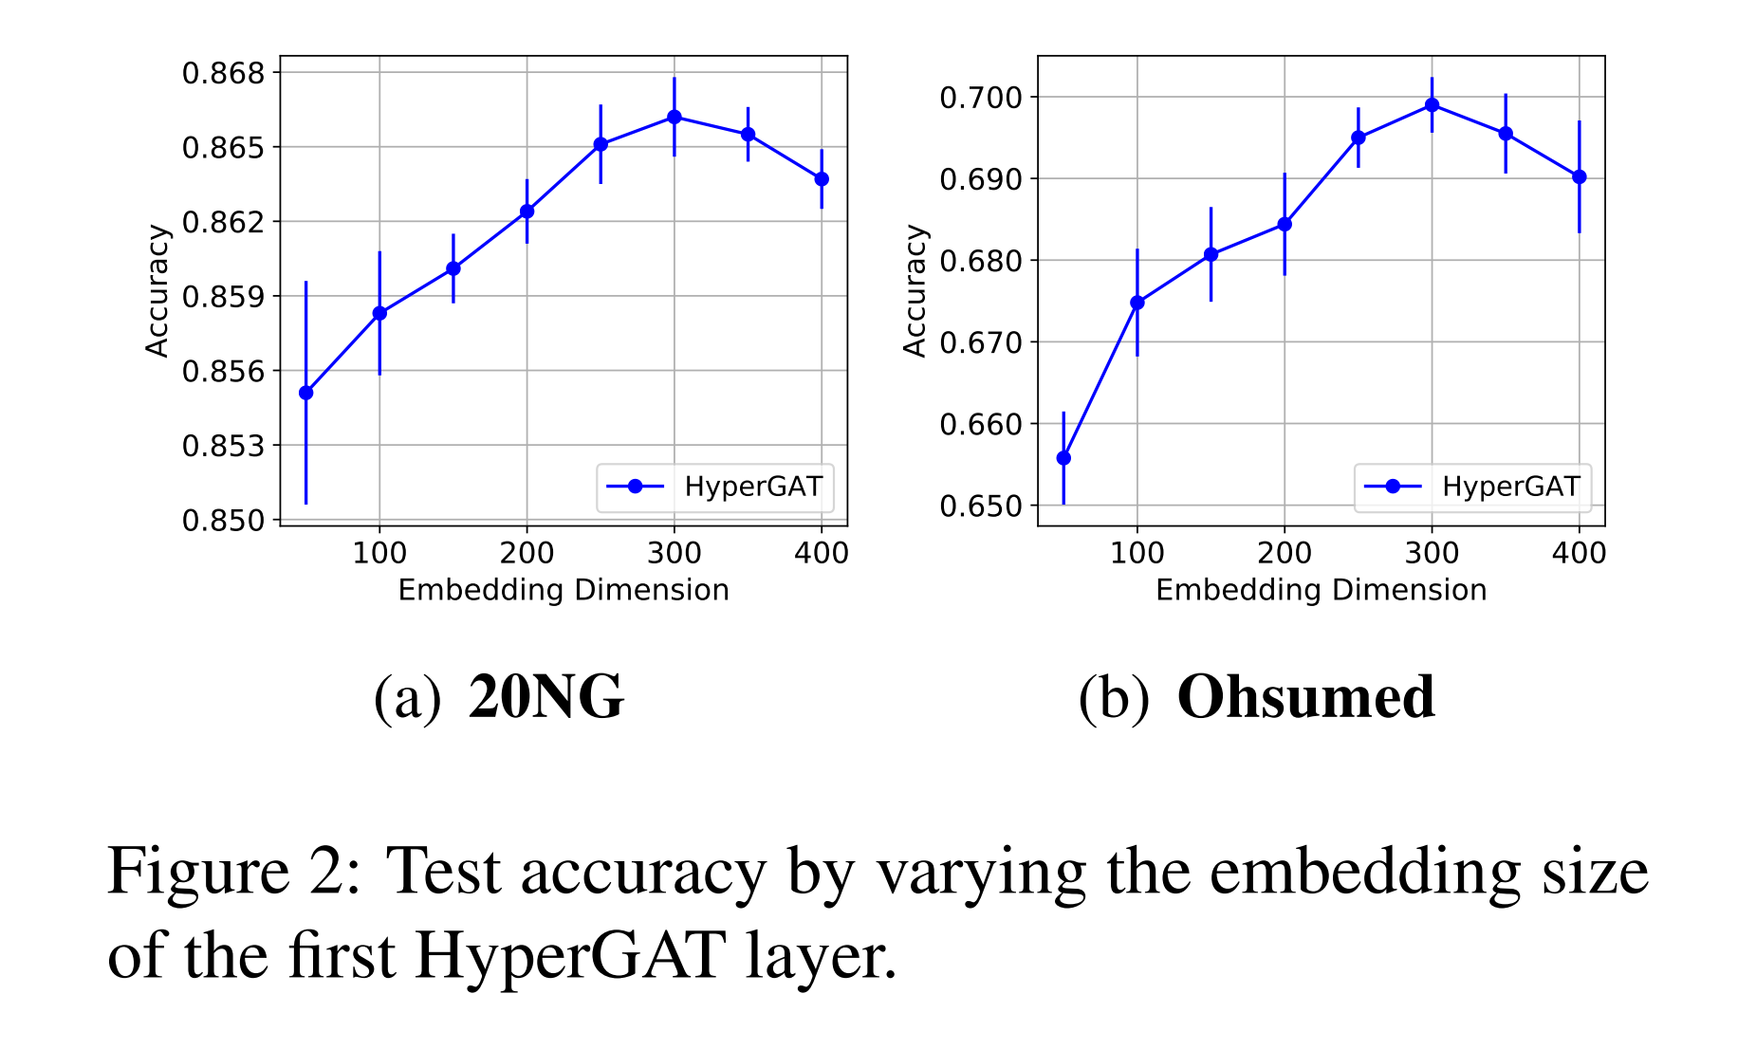
Experiment

Slide 15
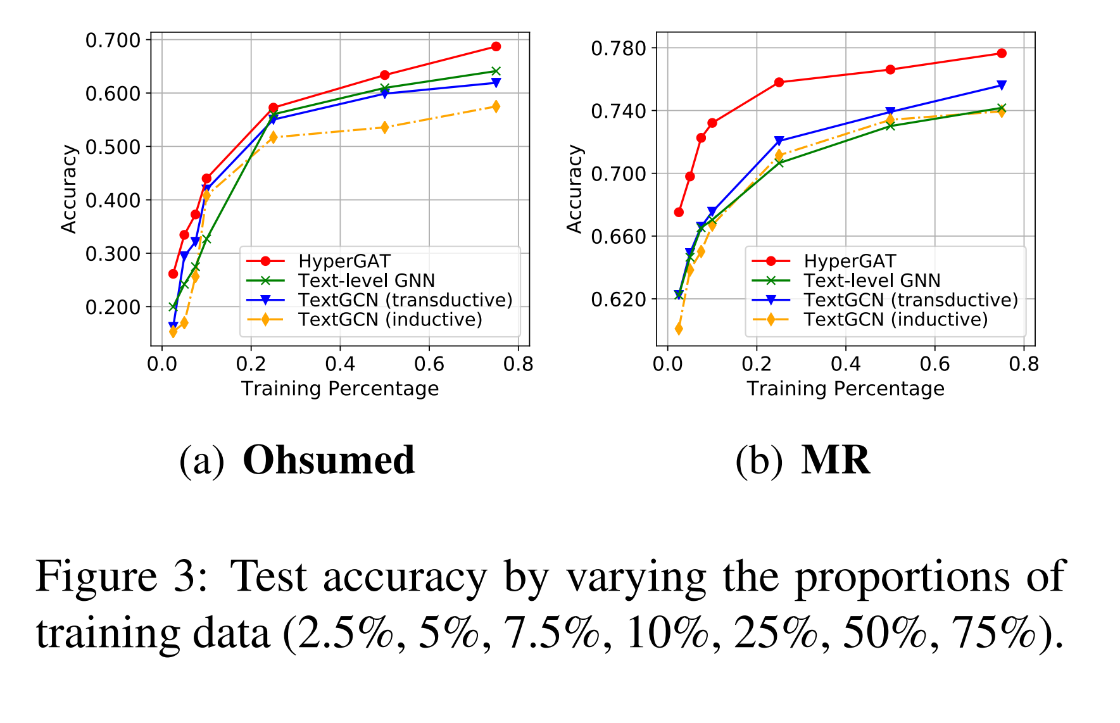
Experiment

Slide 16
Experiment

Slide 17
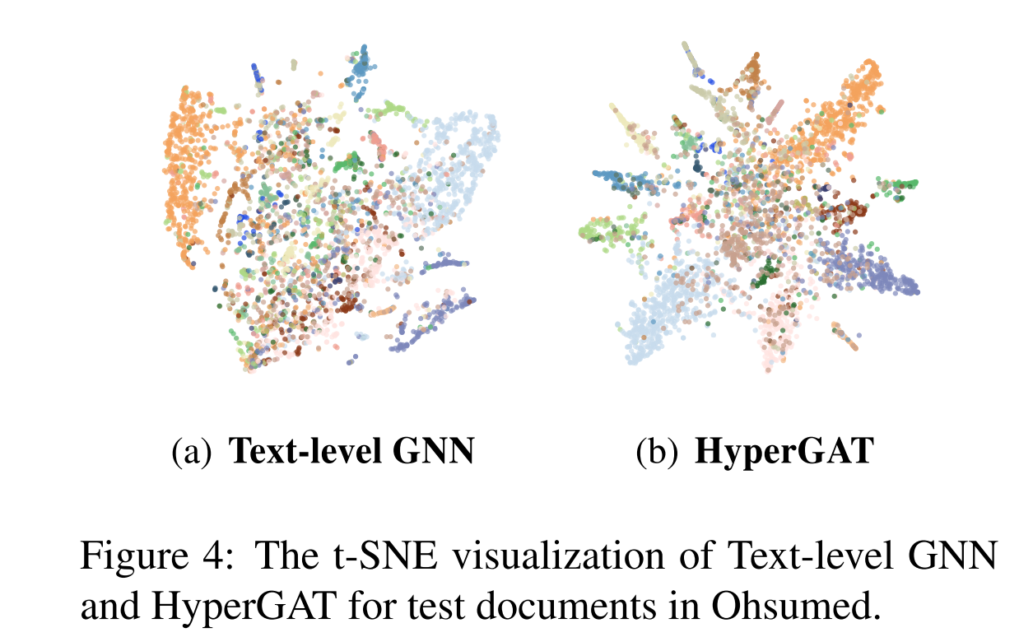
Experiment

Slide 18
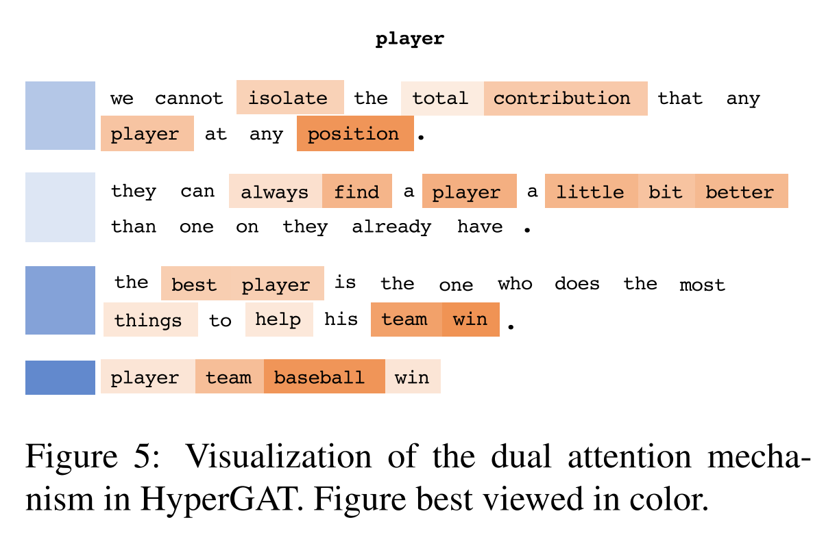
Experiment

Slide 19
Thanks

